Slide 1
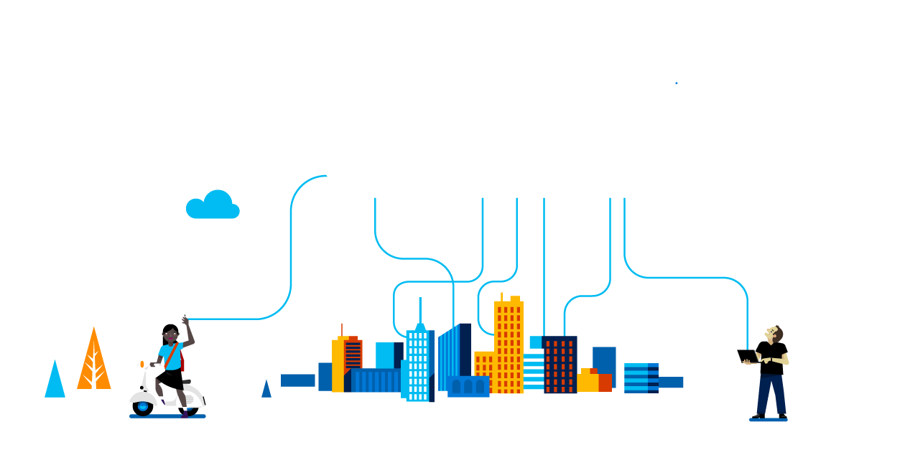
All about The Internet of Things
Professor Paul DeCarlo
Microsoft Tech Evangelist

Slide 2
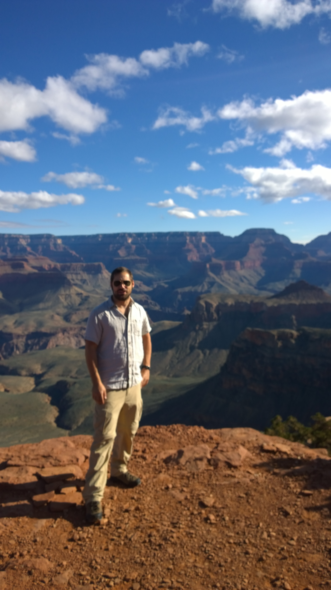
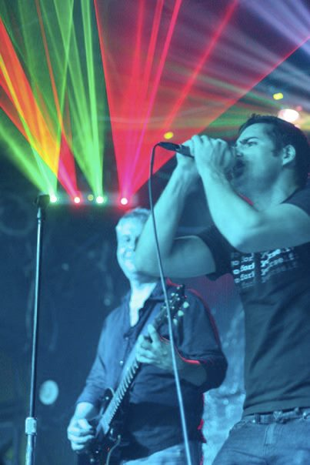
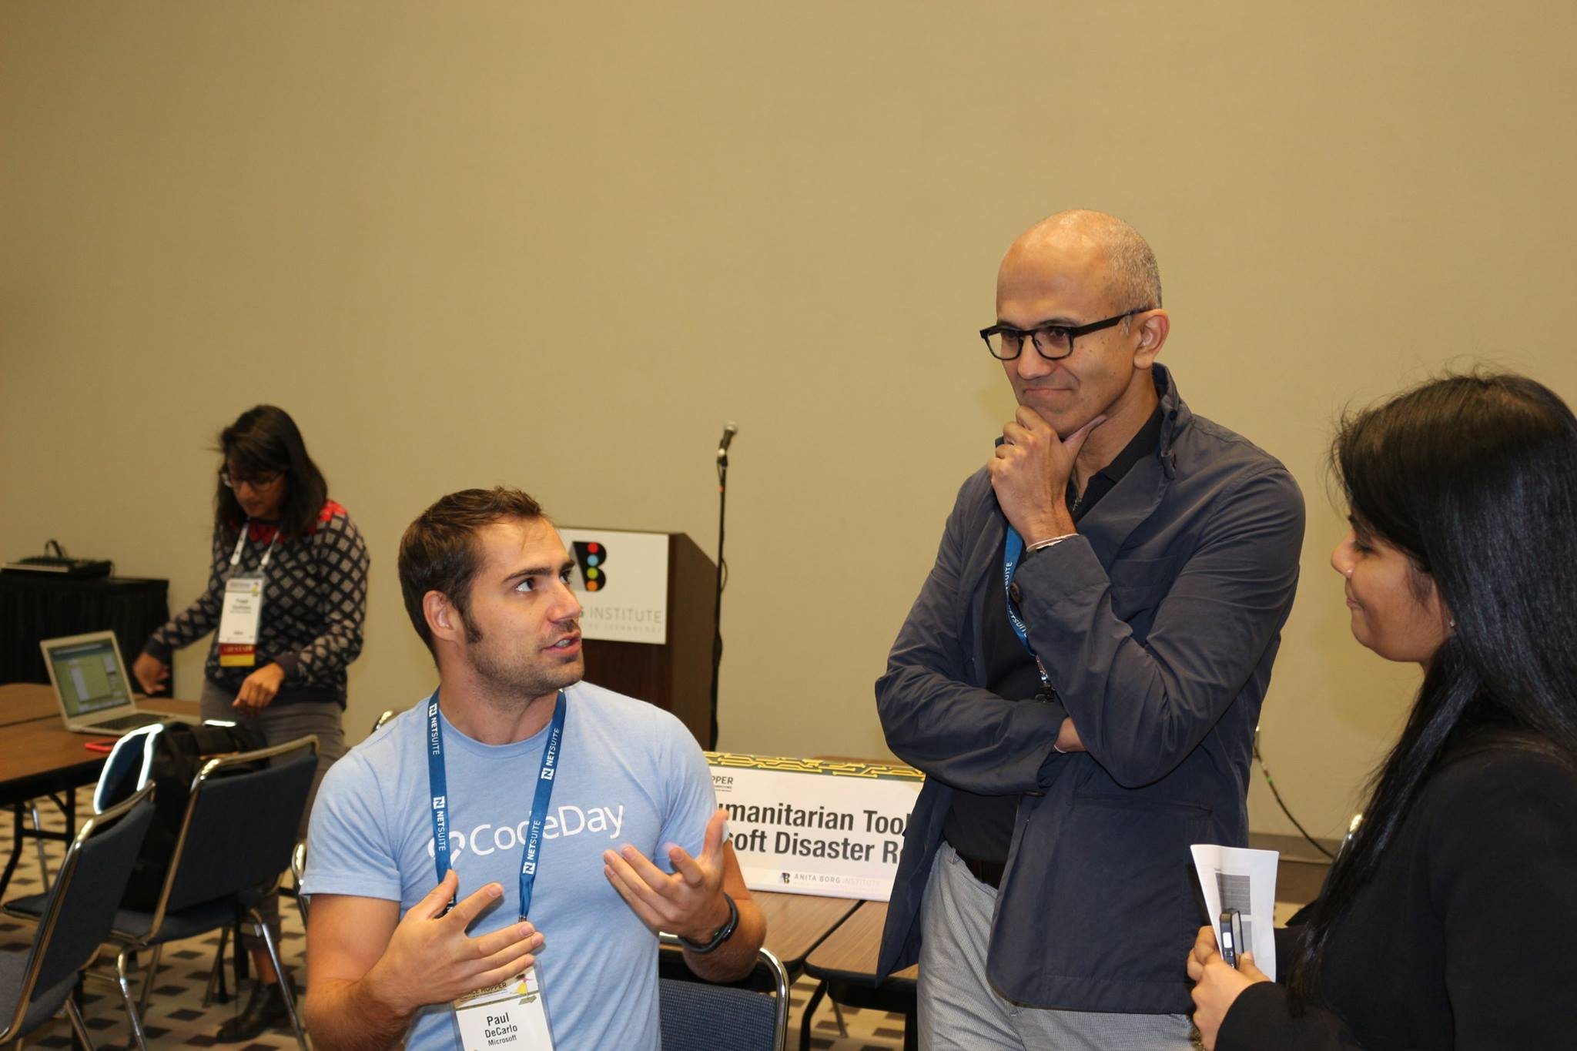
Who am I?
Paul DeCarlo | @pjdecarlo
Sr. Technology Evangelist
Blog pjdecarlo.com
pdecarlo@microsoft.com
Fun Stuff
Current Hometown of Houston, TX
Sing in a Band
Love the outdoors
Met Satya Nadella (CEO of MSFT)

Slide 3
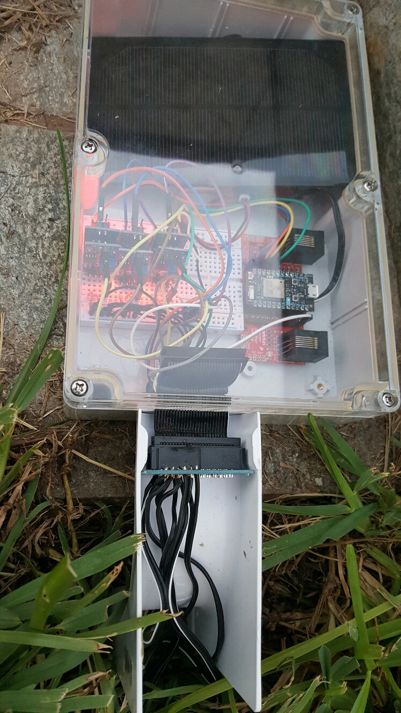
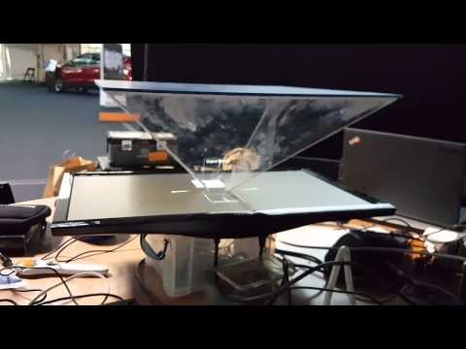
IOT Hacks Are Cool
HelloHolo – Real Time Translating Hologram TechCrunch Disrupt 2015
Internet of Trees
Notes:
Why is Microsoft and IoT important to you? Simple… IoT hacks are cool! Some would say it is the perceived difficulty, but hardware isn’t hard anymore. Advances in software and technology in general have made it easier than ever to cross the once very wide chasm. Simply put… If you can write software, you can program for hardware, I would argue they are like bread and butter. Others might state that these are complete solutions with real-world effects. Most IoT solutions incorporate hardware in the form of physical sensors, software in the form of app / web interface or both, and some sort of cloud component for operating on received data. As you will see, Microsoft makes it easy to tie your hardware up to the cloud in a few clicks where it may then be consumed from really any device. Seriously, Azure supports VM’s running Windows or Linux, Mobile Services that create backends and APIs in a single click that support platform specific APIs for consumption on IOS, Android, Windows, and web, in addition we support high throughput eventhub services that processing up to a million events per second! Literally scalable solutions at tip of your finger! Seriously, use your finger, and click to get started with scalable solutions right now in the Azure portal!

Slide 4
What is the “internet of things”
Internet of things
Syllabification (Inter•net of things)
noun
A proposed development of the Internet in which everyday objects have network connectivity, allowing them to send and receive data:
Source: Oxford Dictionary, yep, it’s really in the Oxford Dictionary. It got added at the end of August, 2013

Slide 5
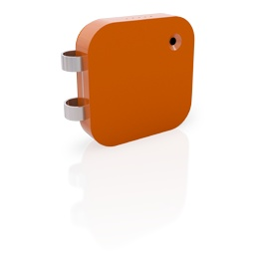

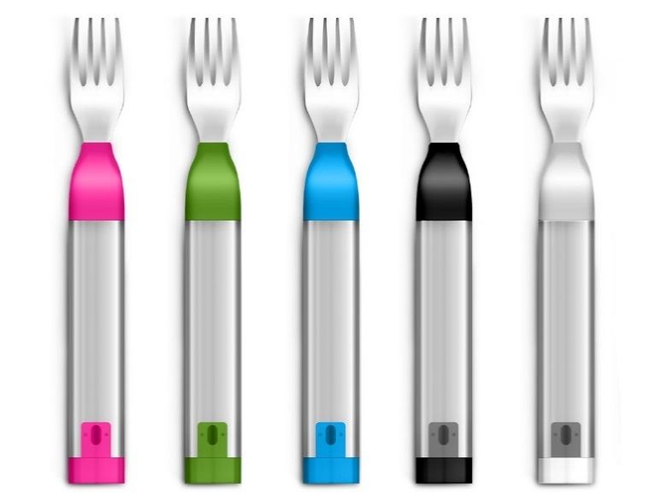
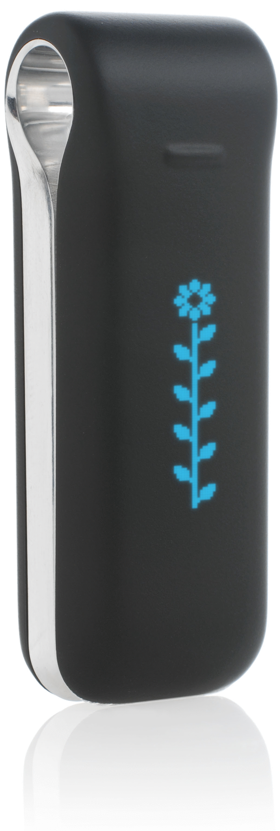

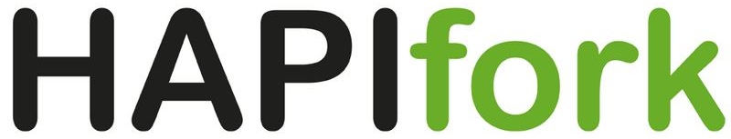
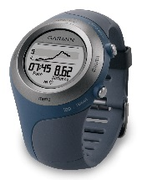

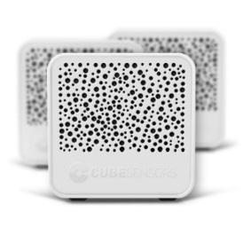
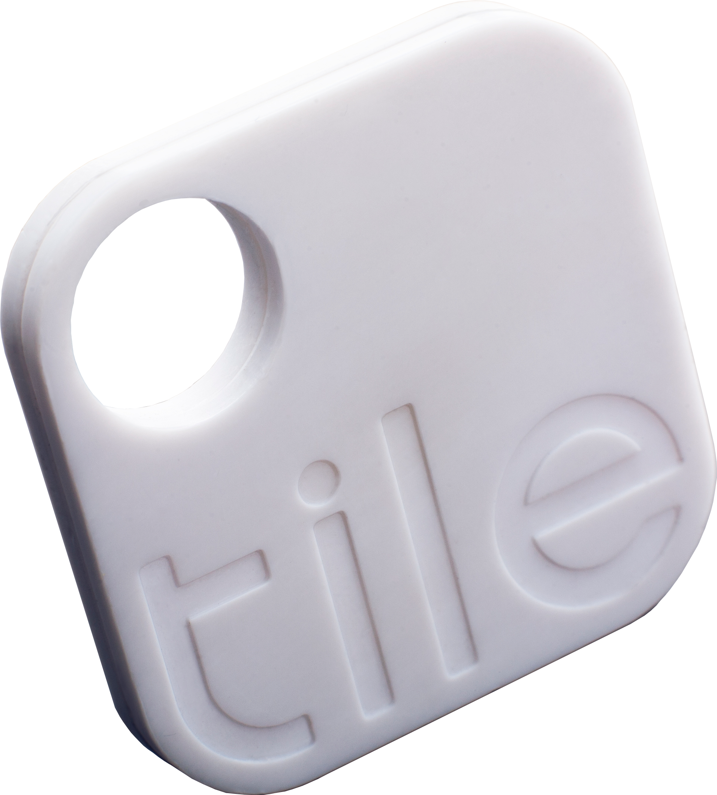


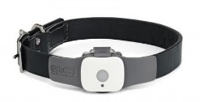
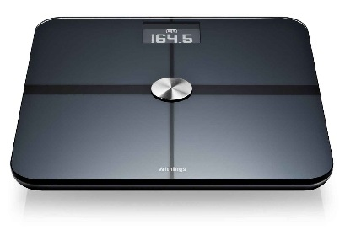


Examples

Slide 6
Enablers
Moore’s Law
Low Power Wireless
Low Power CPUs
Standards
Cloud Computing
Cloud Data Storage
Crowdfunding
Toolsets & Libraries
Rapid Prototyping
Notes:
Moore’s Law (amount of computing power / sq in.)
Low Bandwidth / Low Power Wireless Networking
Lower Power CPUs (Intel, ARM)
Cloud Computing
Cloud Data Storage
Big Data – Hadoop
Convenient prototyping (Arduino, Netduino, 3D Printing)
Standards (MQTT / OMA-DM)
Toolsets (m2m.eclipse.org)

Slide 7
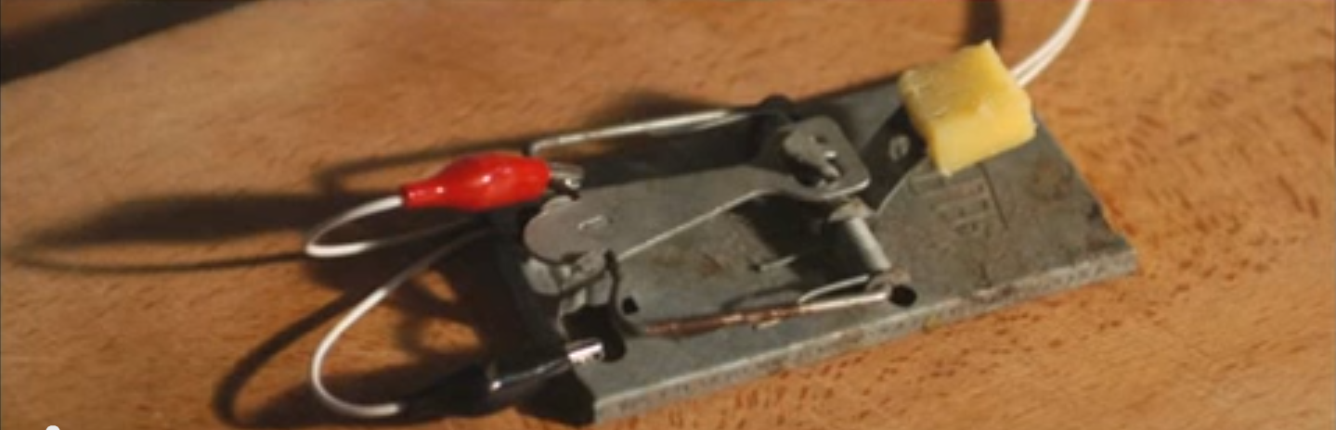
Building a Better Mousetrap
Source: “TEDx Warwick – Andy Stanford-Clark – Innovation Begins at Home”

Slide 8
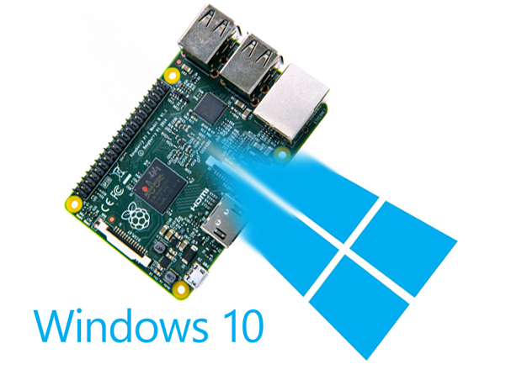
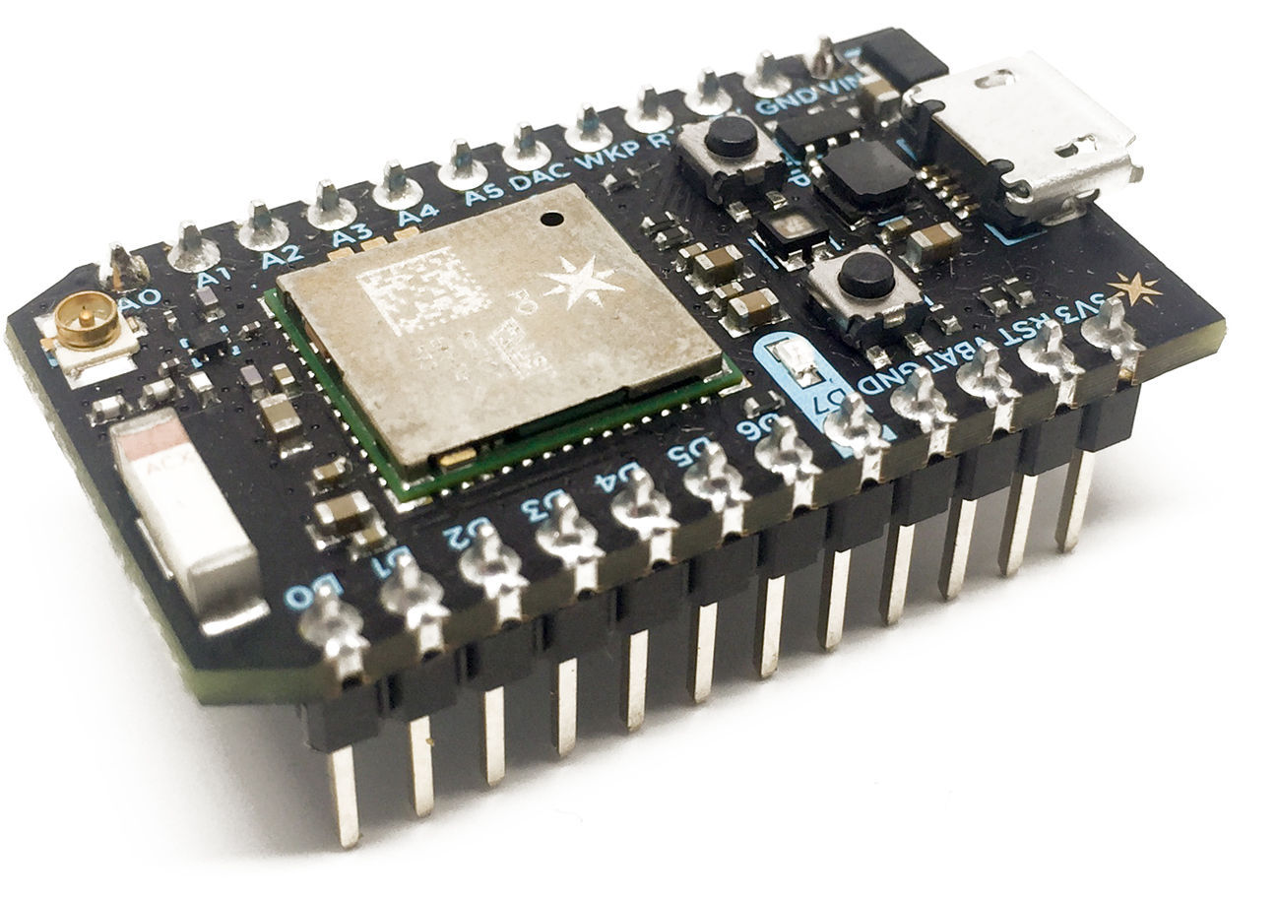
Some Tools of the Trade
Raspberry Pi Microcomputer
Particle Photon Microcontroller

Slide 9
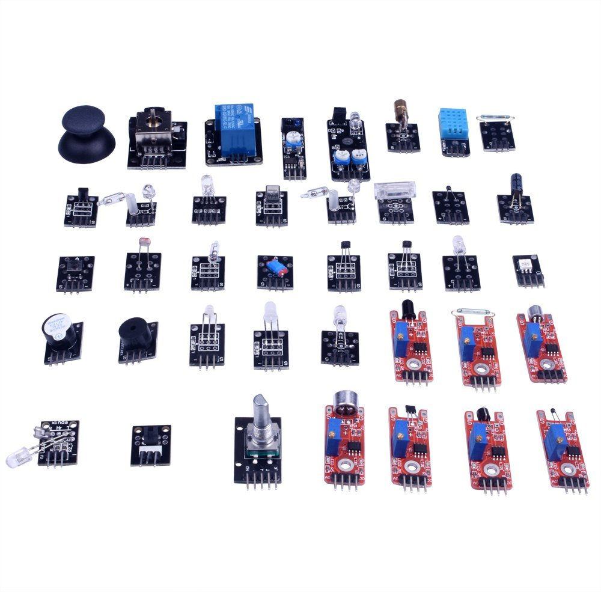
Sensors as building blocks
Common Scenarios:
User Input
Anomaly Detection
Data Logging
Control of external mechanism

Slide 10
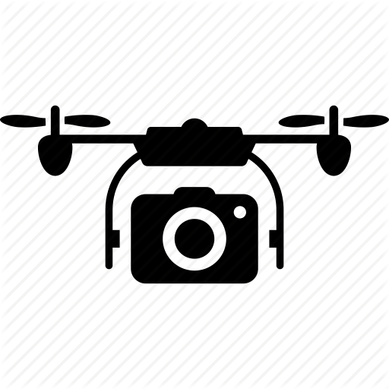
How might you put them together?
Camera = eyes GPS = location

Slide 11
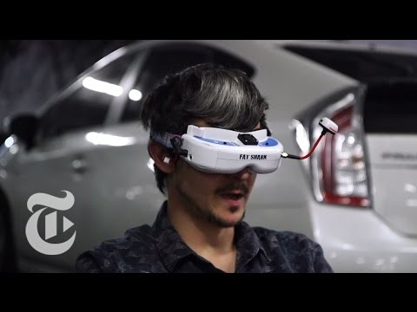
Here’s one idea, VR Drone Racing!

Slide 12

What else though?
Camera + GPS for navigation
Heat Sensor / Luminoscity sensor to detect hot zones
Gas Sensor to detect smoke
Liquid sensor to know when to replenish water

Slide 13
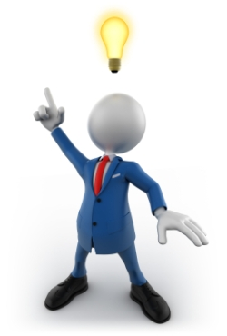
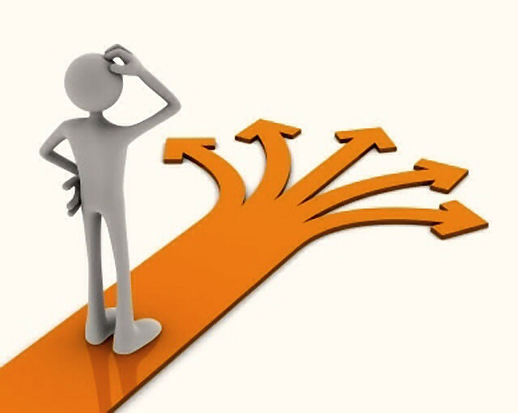
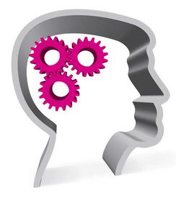
Your turn!

Slide 14
Demonstration
Follow Along @
http://connectthedotsdx.azurewebsites.net

Slide 15
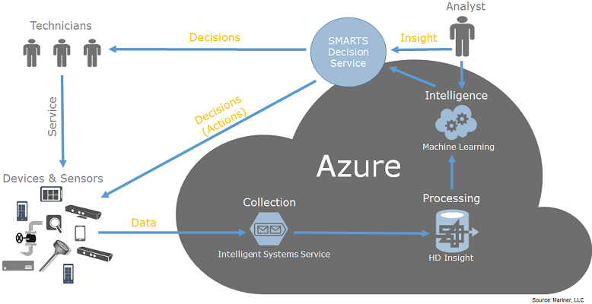
Extending IoT with the Cloud
Fleet management
Data Processing
Predictive Modeling
Anomaly Detection

Slide 16
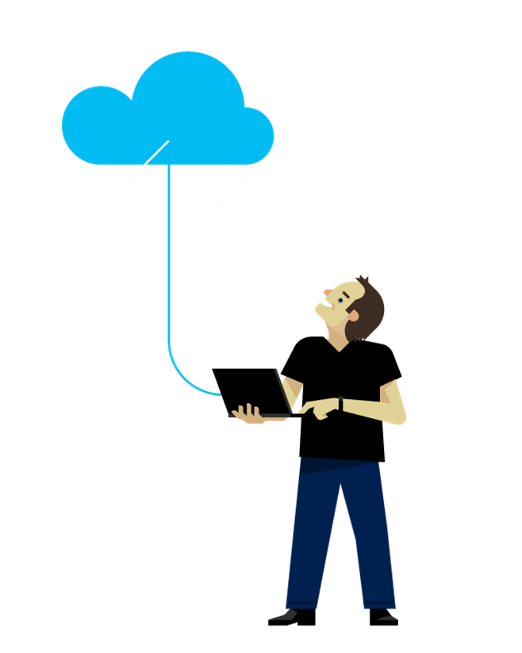
How might you use IoT with the cloud?

Slide 17
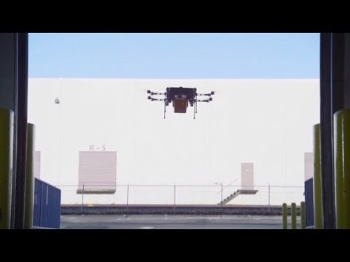
Here’s one idea, drone delivery drivers!

Slide 18
Now let’s hear your ideas!

Slide 19
Conclusion
IoT refers to Internet connected devices that capture and/or react to data online as well as the technologies which store and operate on that data
IoT devices often employ sensors to sense the world around them, sometimes better than a human and other times in ways that humans can not even do
IoT devices can collect data together and learn from each other using Machine Learning models, large datasets imply large computational power
The Cloud allows for operating on large data sets received from IoT devices either in real-time or after the fact, often to create predictive insights

